Slide 1

Restaurant Orders - PEP 1
The Powerpuff Girls aka Amrita, Jasmine, Gabby

Slide 2

Powerpuff Tech’s elite freelance team is on a mission for MojoJojo Inc. We are crafting a restaurant order management system powered by the dynamic duo: Pandas and SQL. Mojo Jojo Inc. wants to skyrocket revenue, and we’re here to make it happen! What’s our secret? An Extract-Transform-Load (ETL) pipeline that transforms data from files for analysis. Get ready for an adventure in data driven dining!

Slide 3
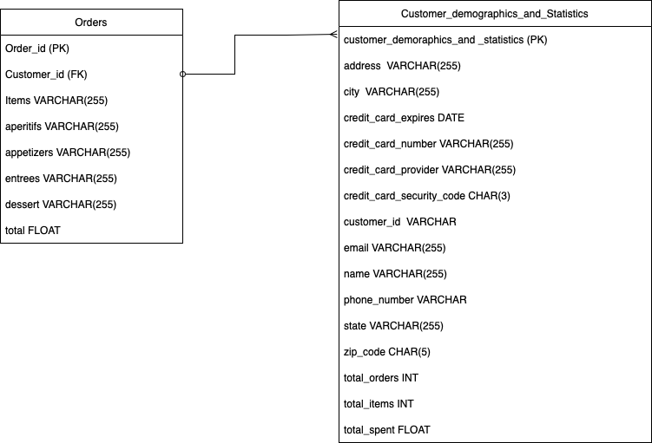

Merging Tables for Power-Packed Insight
The girls opted to craft the ER diagram first before extracting data. To achieve this, they merged the customer demographics and statistics table to establish a one-to-many relationship with the orders table

Slide 4

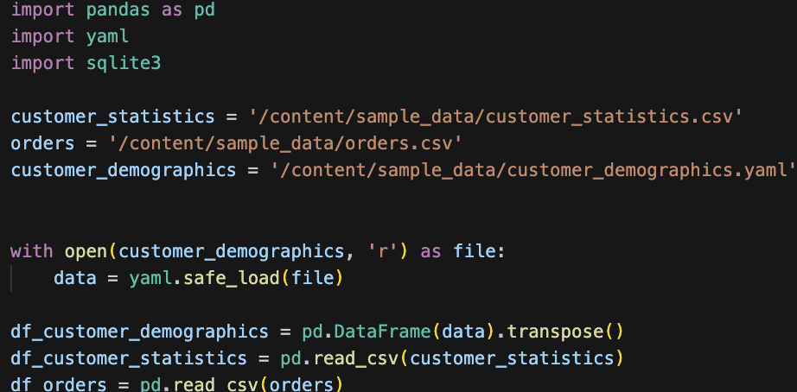

The Powerpuff Girls’ YAML Magic Unleashed
The villain HIM trapped in .csv and YAML files, seeks the Powerpuff girls tech skills to extract data. The trio used ‘import yaml’ and converted them to a pandas dataset to effortlessly save the day.

Slide 5
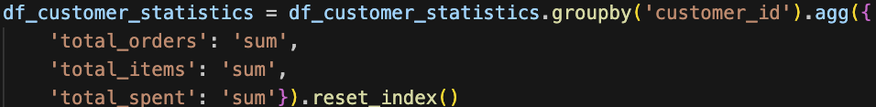

Busting Repetition: Buttercup's Quest for Unique IDs
Faced with the challenge of customers having multiple entries in customer_statistics, Buttercup harnessed her tech genius to aggregate and transform the data landscape. The result? A triumph over the repetition, paving the way for uniquely identified patrons, granting HIM newfound insight for customer analytics.

Slide 6

Buttercup’s Inner Join Adventure
To remedy the data imbalance between customer_demographics and customer_statistics Buttercup executed a merge using command:
By using inner join, Buttercup filtered out any customer_demographics that didn’t have any corresponding customer_id in customer_statistics.
This ensures that the merged dataset is focused solely on orders with optional associated customers.

Slide 7

Symphony of Data Unification
With a stroke of code, Buttercup orchestrated a union, creating a final merged dataframe. This strategic move set the stage for Blossom to uncover comprehensive insight propelling the girls further into their tech adventure.

Slide 8
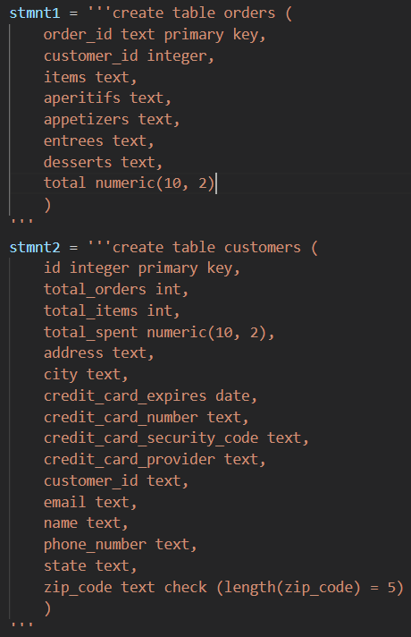

Blossom Unleashes Charm in Data Insertion
Used SQLite to create tables and database
Challenging to keep track of all data columns and implement proper constraints and checks
Plenty of trial and error involved!

Slide 9
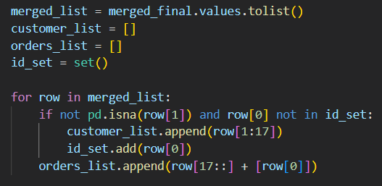

Cont.
Decided to extract data from final merged dataframe… for fun!
Merged dataframe had order info for every row, but not always customer info
Customer info could also repeat, so only unique customers could go into table
Had to separate customer info and order info into different lists to be inserted separately via SQLite

Slide 10
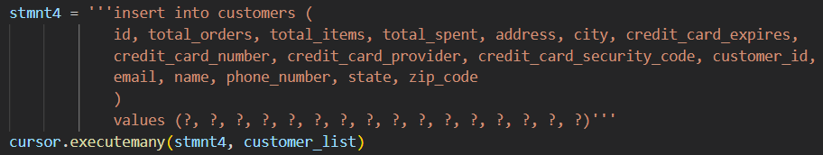
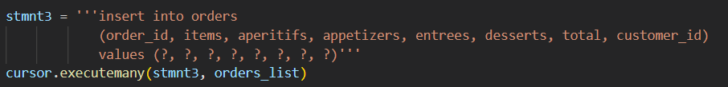

Blossom harnessed SQLite magic to craft tables and shape the database. Navigating data columns with precision posed a challenge, but she embraced trial and error and turned obstacles into tech triumphs!

Slide 11
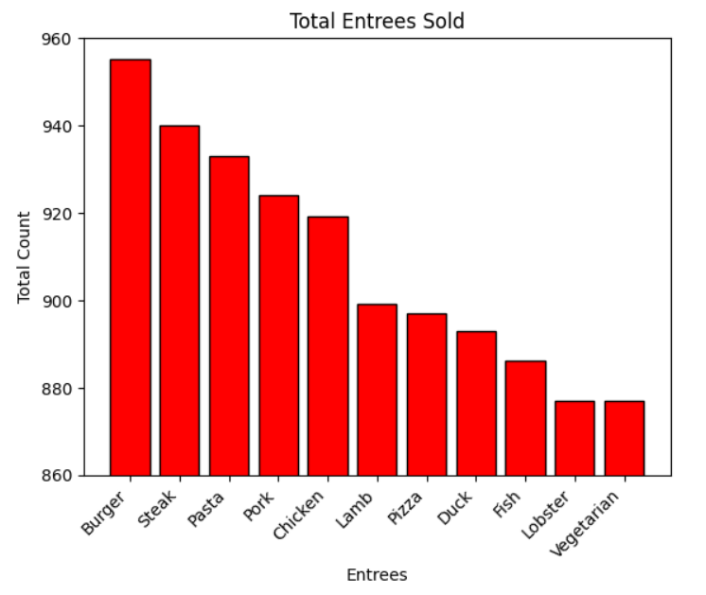
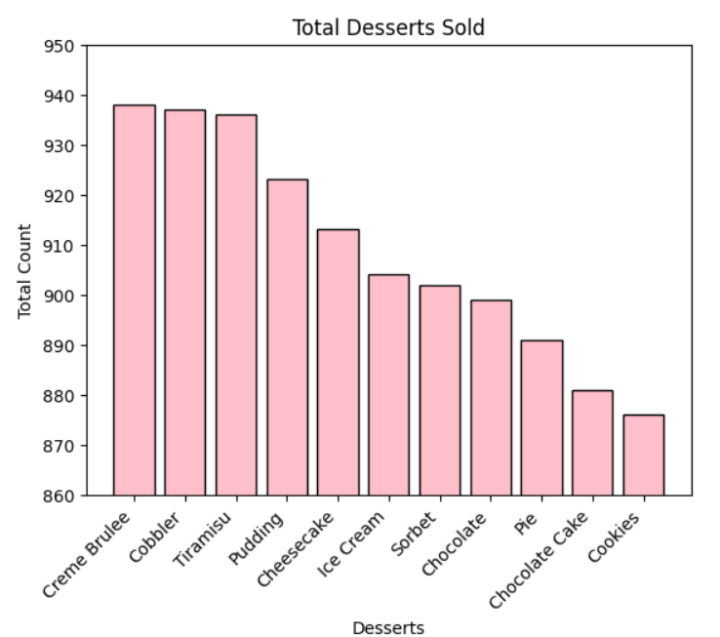

Bubbles Data Delight: Charting Culinary Success
Notes:
Hi, my name is Bubbles, I will be discussing the visualization and analysis of the data.
I wanted to identify the most popular items for each category.
Starting with the graph on the left, Burger, Steak, and Pasta are the top-selling entrees.
On the right, Creme Brule, Cobbler, and Tiramisu are the top-selling desserts.

Slide 12
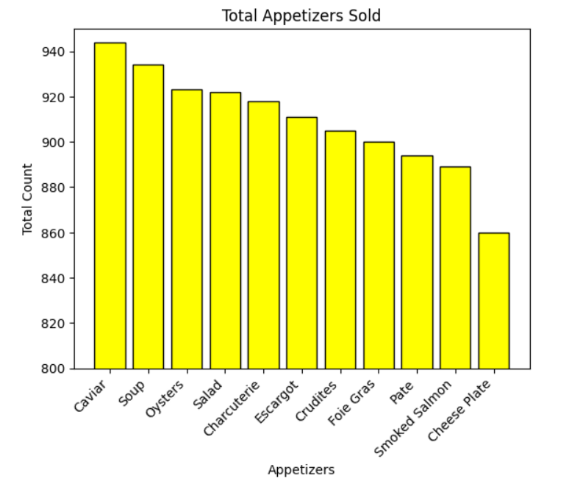
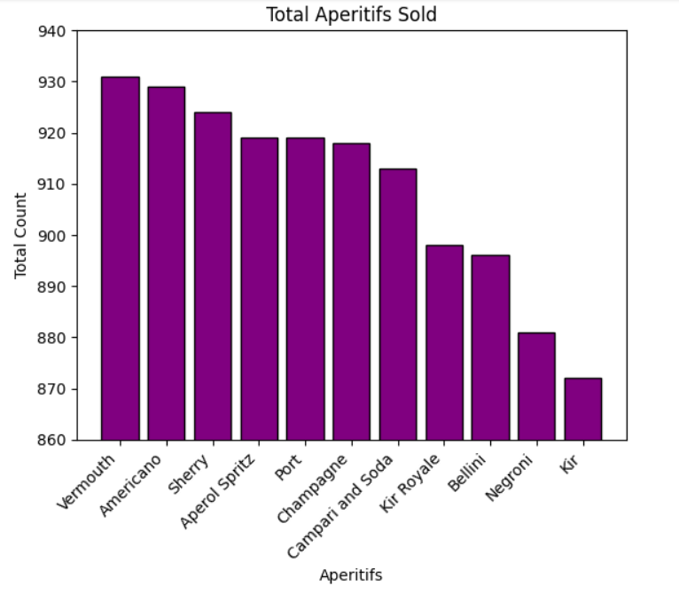

Visualization Pt2.
Notes:
On the left we have Vermouth and Americano as the top-selling aperitifs.
On the right we have Caviar and Soup as the top-selling appetizers.

Slide 13
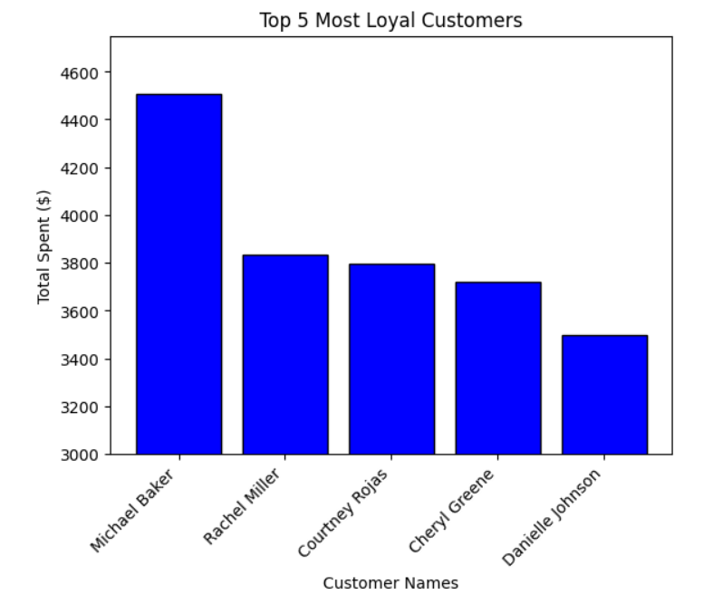

Visualization Pt3.
Notes:
Here, I wanted to do a customer analysis to identify the top 5 most loyal customers based on their total spending.
5 Most Loyal Customers:
Michael Baker - $4508.25
Rachel Miller - $3835.53
Courtney Rojas - $3795.68
Cheryl Greene - $3722.52
Danielle Johnson - $3498.03
Observations & Recommendations:
Top 5 customers exhibit significant loyalty, with Michael Baker being the highest spender at $4508.25.
Consider implementing or enhancing loyalty programs to further engage and retain these high-spending customers.
Assess the popularity of specific menu items among the top spenders and consider optimizing the menu based on their preferences.

Slide 14
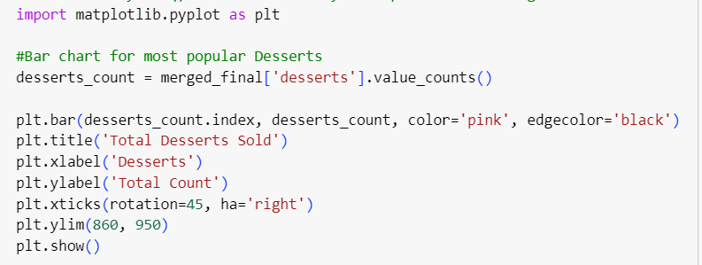

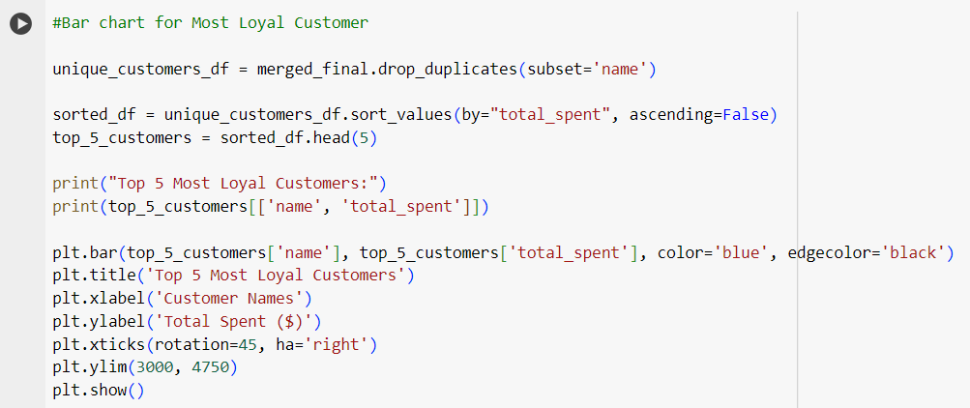
Bubbles’ Data Dive
Entrees, Desserts,
Aperitifs,
Appetizers
Notes:
Here is the code I’ve implemented to create all 5 graphs.
At the top, I wanted to identify the most popular items for entrees, desserts, aperitifs, and appetizers sold.
I first had to extract data from the merged dataset, and calculate the count for each item to visualize their popularity.
Then I went ahead and created the bar graphs for each category including the titles, x and y axises, labelling, and making sure the bars looked pretty.
In the bottom code, I wanted to do a comparison between the “name” column and “total_spent” column to identify top 5 most loyal customers that have spent their money .
Based on the “name” column, I had to remove any duplicates to ensure that each customer is represented uniquely.
Then I had to sort the dataset in descending order based on the “total_spent” colun, to identify the highest-spending customers.

Slide 15

Making Waves with Insights for Mojo Jojo Inc.
Armed with visualizations and insightful analysis, Bubbles took center stage at Mojo Jojo Inc. Ready to revolutionize their culinary landscape, she shared a wave of strategic recommendations:
Introduce seasonal items for variety.
Use promotions for top sellers.
Adjust inventory based on popularity.
Offer pairing suggestions for a better experience.
Introduce combo deals with popular appetizers.
Notes:
Introduce seasonal items or limited-time offers to keep the menu fresh and attract customers looking for variety
Implement targeted promotions for the top-selling items to further enhance their popularity
Adjust inventory levels based on the popularity of items to prevent shortages or excess stock
Provide pairing recommendations for aperitifs with specific entrees or desserts to enhance the overall dining experience
Introduce combo deals that include popular appetizers to encourage customers to try a variety of options

Slide 16

The Powerpuff Girls Conquer Roadblocks
Issues formatting graphs
Limiting y-axis range to make differences more apparent
Figuring out how handle null and repeating values
Unfazed , Blossom, Bubbles and Buttercup turned challenges into stepping stones on their path to mastery by unraveling complexities!
Notes:
Adjusting the y-axis range on the graphs to highlight and make the differences between data points more apparent. This helps in emphasizing variations and trends by focusing on a specific range of values, making the visual representation more impactful.
Figuring out whether to omit, replace, or interpolate missing data to maintain the integrity of the visualization.
Exploring options such as grouping, aggregation, or using different visual elements to prevent redundancy and enhance clarity in the graphs.

Slide 17

Next Sprint?
Implement functionality for adding additional data from new files
Abstract code blocks into reusable functions
Create user interface
Notes:
Develop a feature that allows users to seamlessly incorporate data from new files into the existing system.
Identify common tasks or operations within your code and encapsulate them into reusable functions.
Design and implement a graphical interface that allows users to interact with your system easily.

Slide 18

DEMO TIME!
Notes:
I imported matplot library to create the 5 bar graphs.
For the first code, I extracted data from the merged dataset, and used one category at a time to calculate the total for each item.
Then I created the bar graphs to see which items had the most popularity for each category.
For the second code, in order to do customer loyalty analysis, this time I had to compare two columns “name” and “total_spent” to identify the highest-spending customers.
I also had to remove the duplicates to ensure that each customer is unique, then sorted in descending order based on total_spent
Finally I wrote a short analysis for each graph and added suggestions as to how Mojo Jojo can improve on running his business in the future.
THE END.

